Slide 1
Welcome

Slide 2
Creative Cloud for Teams / Value Incentive Plan
Pieter van Helvoirt

Slide 3


A new era of communication
customers are in a publishing whirlwind.
Almost overnight your customers have been compelled to publish across a sky-wide spectrum of media and deliver brilliant communications to laptops, smartphones, tablets, television, websites and traditional media in a timely and cost-effective manner. You’ll be positioned to succeed, if you can help.
The Cloud is making it easier than ever before to deliver the right technology at the right time--at the right price. Take 15 minutes to read this presentation about Adobe's Creative Cloud for teams, and find out how you can effectively sell it to your accounts.
Since technology is moving faster than a traditional 12-24 month software upgrade cycle, the way that Adobe delivers software – and value – to your customers just isn’t cutting it anymore.
In order to keep up with the ever changing technology, Adobe needed to remove the barriers that exist with the traditional 12-24 month software release cycle.
Our business required a change.
Presenter Notes:
Apps
News
Revenue
Vertical Industries
Advertising
Print
Social Media
Mobile
Engagement
Television
Collaboration
IOS
Mobility
Free
e-Commerce
Digital Magazines
iPad
Windows 8
Android
Repurpose Content
Brand Promotion

Slide 4

Digital Experiences in a Multiscreen World

Slide 5
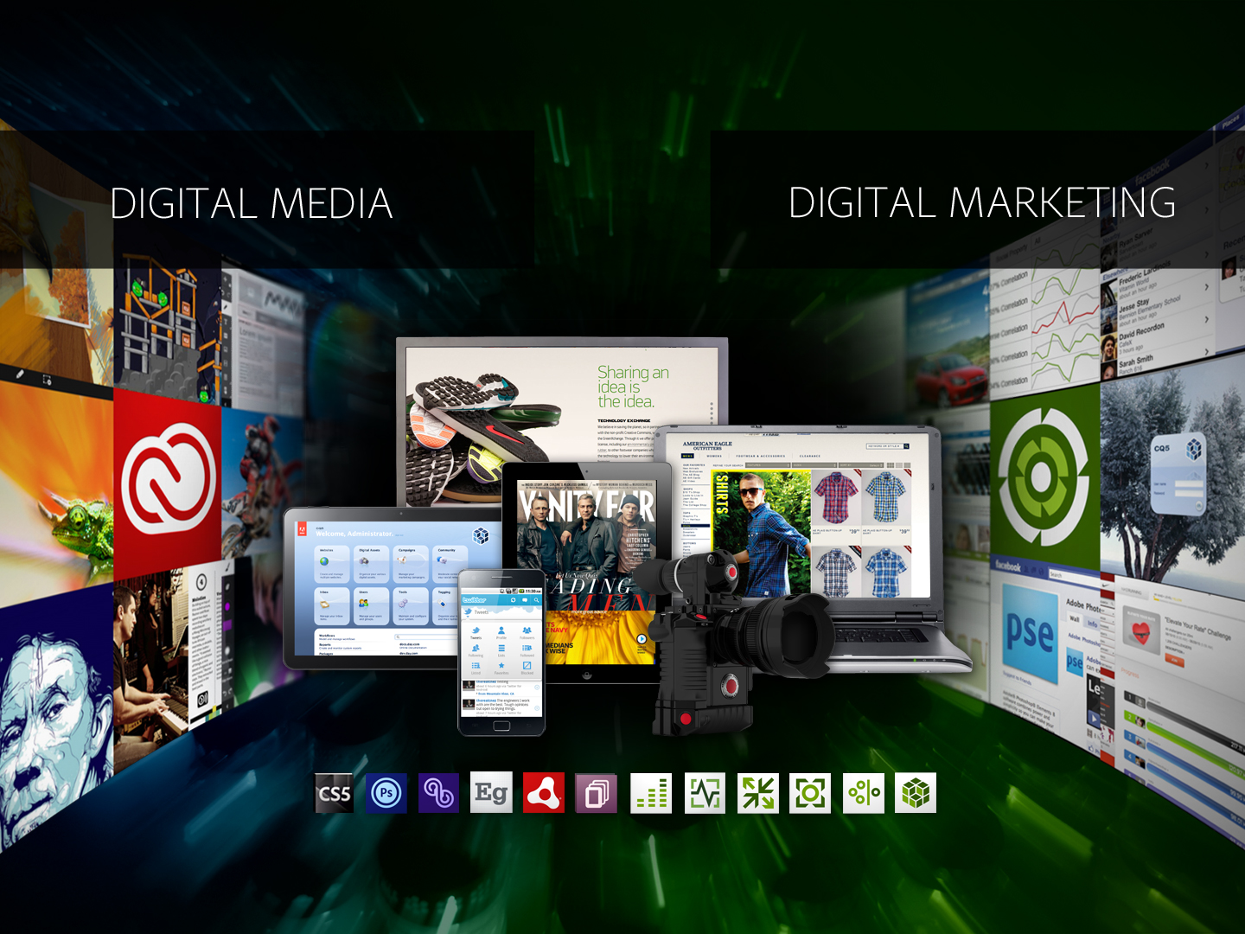

Slide 6





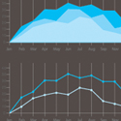


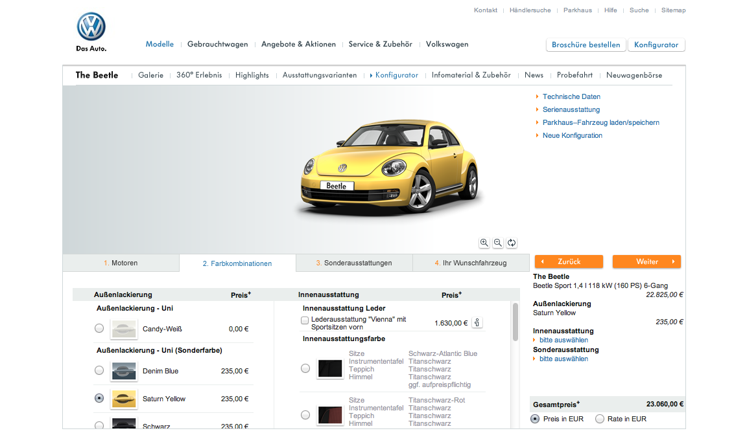
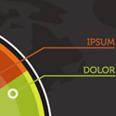

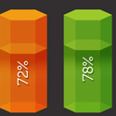


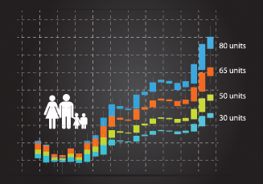
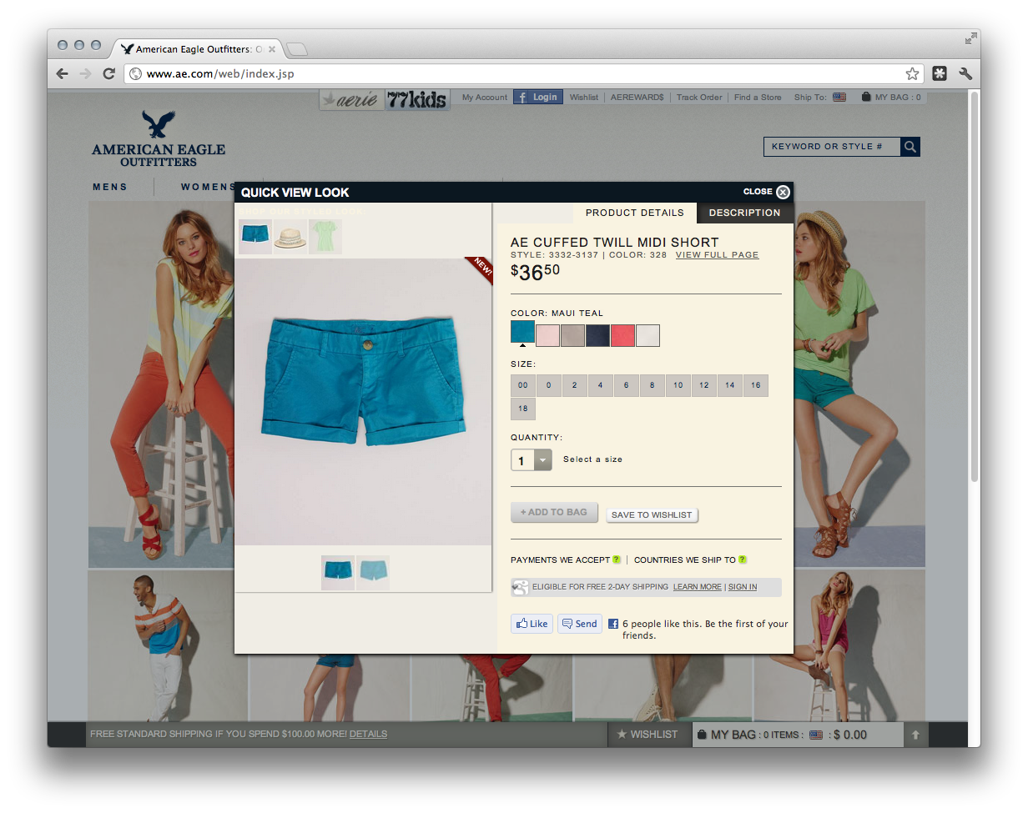


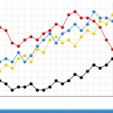


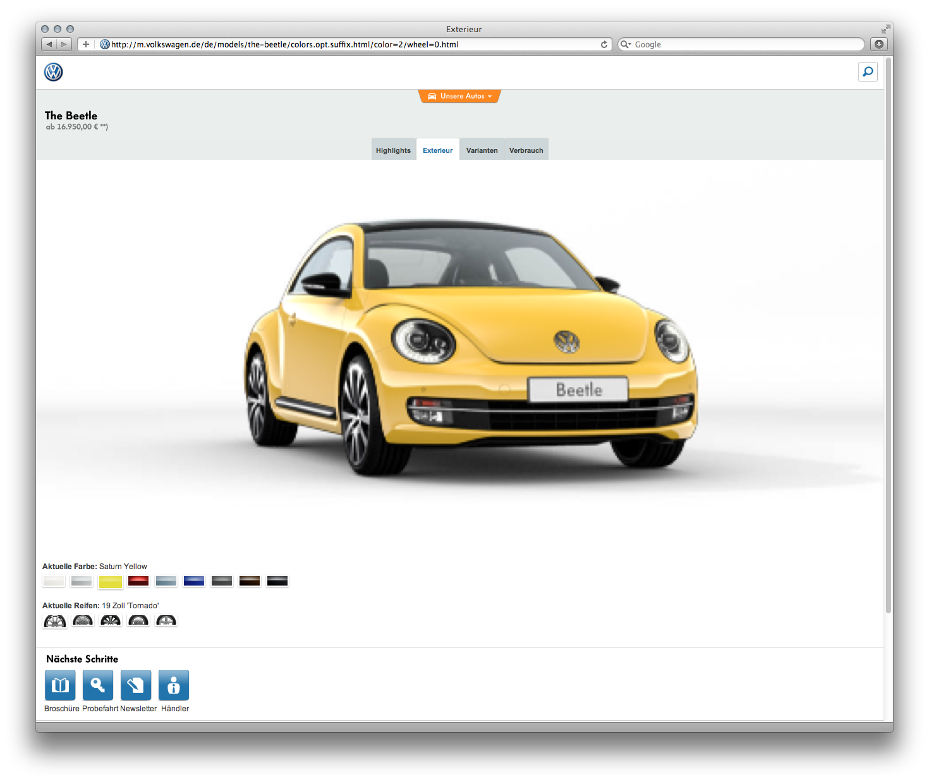












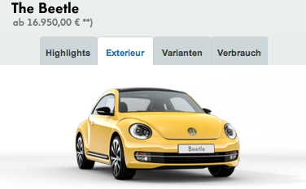
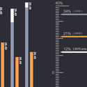


What We Do
MAKE
MANAGE
MEASURE
MONETIZE

Slide 7
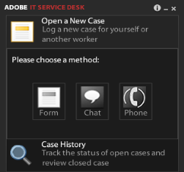

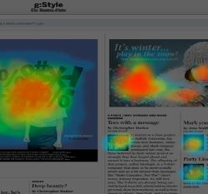








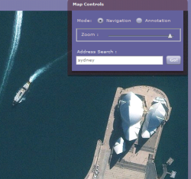







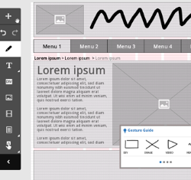


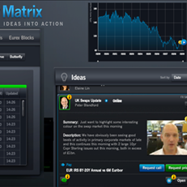
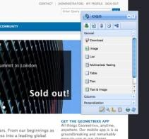
Changing the world through digital experiences

Slide 8
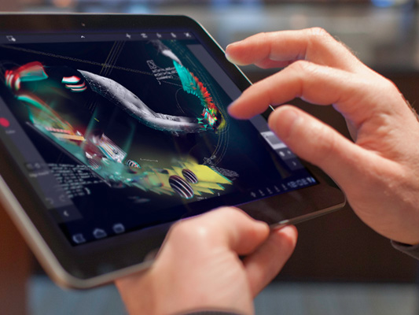
Customer Needs
Keep up to date with core technologies
Quick support for new devices
Access wherever they need it
Collaboration
Cloud based services
Lower cost of entry

Slide 9








Adobe Creative Cloud
So we changed the way we deliver software by introducing Adobe® Creative Cloud™…
…an ongoing membership that lets individuals download and install any of the Adobe Creative Suite® 6 desktop applications, plus other applications including Adobe Lightroom® 4.
…all of the latest apps and features as soon as they are released, giving individual creative users the freedom to create anything they can imagine, and stay ahead of changing technology
Presenter Notes:
The internet
CREATIVE CLOUD
Download and install all the latest applications

Slide 10
Creative Cloud Success
The introduction of Creative Cloud individual membership has been a great success for Adobe, with more than 200,000 memberships sold in the 6 months since its release. It is also reaching new customers, since nearly 40% are new to Creative Suite.
Presenter Notes:
360.000+
individual memberships in 8 months

Slide 11
Creative Cloud Success
40%
40%
88%
New to Creative Suite
Would not have bought otherwise
Annual Commitment
Individual Creative Cloud customers

Slide 12
Licensing Customers
The early success of Creative Cloud has come from just part of the overall market – individual users.
Nearly half of the installed base of users are licensing customers working in teams. We know this because they have purchased some form of licensing from you.
Notes to Presenter:
Presenter Notes:
Individuals
Teams
Creative Suite
Installed Base

Slide 13
Creative Suite Licensing Install Base
Licensing
Customers
69%
25%
Organizations are in a “non-creative” industry
Licensing customers with 1000 or more desktops in their organization
Average number of creative users in a workgroup = 7
Creative Suite licensing Installed base

Slide 14

Licensing Customer Needs
Immediate access
Predictable budgeting
Easier compliance management
Easier license management
Closed workgroup collaboration
Increased support

Slide 15

Create Now
1
Creative Cloud gives you everything you need to create anything you can imagine
Creative Cloud is the best way for Creative Pros to continue to receive the latest innovation from Adobe – at no extra cost
You can now get Creative Cloud for your team
2
3
#createnow

Slide 16




Slide 17




Major Additions Since April 2012 Launch
Publish Apps & Websites
Sync, Store & Share
Publish Apps & Websites
The World’s Best Tools
Sync, Store & Share
Stay a Step Ahead
New features for Designers in Illustrator and Adobe Muse

Slide 18
Major Additions Since April 2012 Launch
Publish Apps & Websites
Sync, Store & Share
Publish Apps & Websites
The World’s Best Tools
Sync, Store & Share
Stay a Step Ahead
Unlimited publishing to iPad with Digital Publishing Suite, Single Edition

Slide 19
Major Additions Since April 2012 Launch
Publish Apps & Websites
Sync, Store & Share
Publish Apps & Websites
The World’s Best Tools
Sync, Store & Share
Stay a Step Ahead
Edge Tools & Services for creating beautiful, mobile-ready content and apps with HTML, CSS, and Javascript

Slide 20
Major Additions Since April 2012 Launch
Publish Apps & Websites
Sync, Store & Share
Publish Apps & Websites
The World’s Best Tools
Sync, Store & Share
Stay a Step Ahead
New Photoshop and Muse features, desktop sync, and Creative Cloud Training

Slide 21
News Announcements for December 11, 2012
At 19:00 CET on December 11, 2012 Adobe will announce and ship these exclusive additions to Creative Cloud:
A major set of new Photoshop features
New Adobe Muse features to design mobile websites
Desktop sync and collaborative sharing
1
2
3
New Creative Cloud Training
Creative Cloud for teams
4
5

Slide 22
Coming December 11: Major Set of New Photoshop Features
The World’s Best Tools
Sync, Store & Share
Publish Apps & Websites
Stay a Step Ahead
WORK SMART | CREATE FLUIDLY | DESIGN AMAZING 3D ARTWORK
Smart Object support for Blur Gallery Smart Object support for Liquify Conditional Actions New workflow timesavers Pen Tool enhancement | HiDPI and Retina display support * CSS export for text and shape styling Import color swatches from CSS and HTML files Support for larger JPEGs Default type styles | Improved 3D effects Image-based lighting enhancements Enhanced details for textures with normal map generation
* Coming to Creative Cloud members first, but coming to all customers later this year

Slide 23
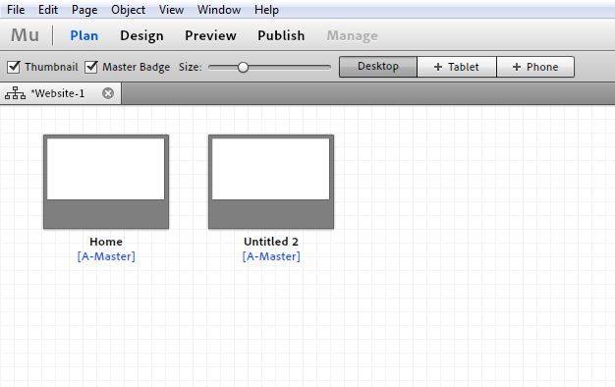
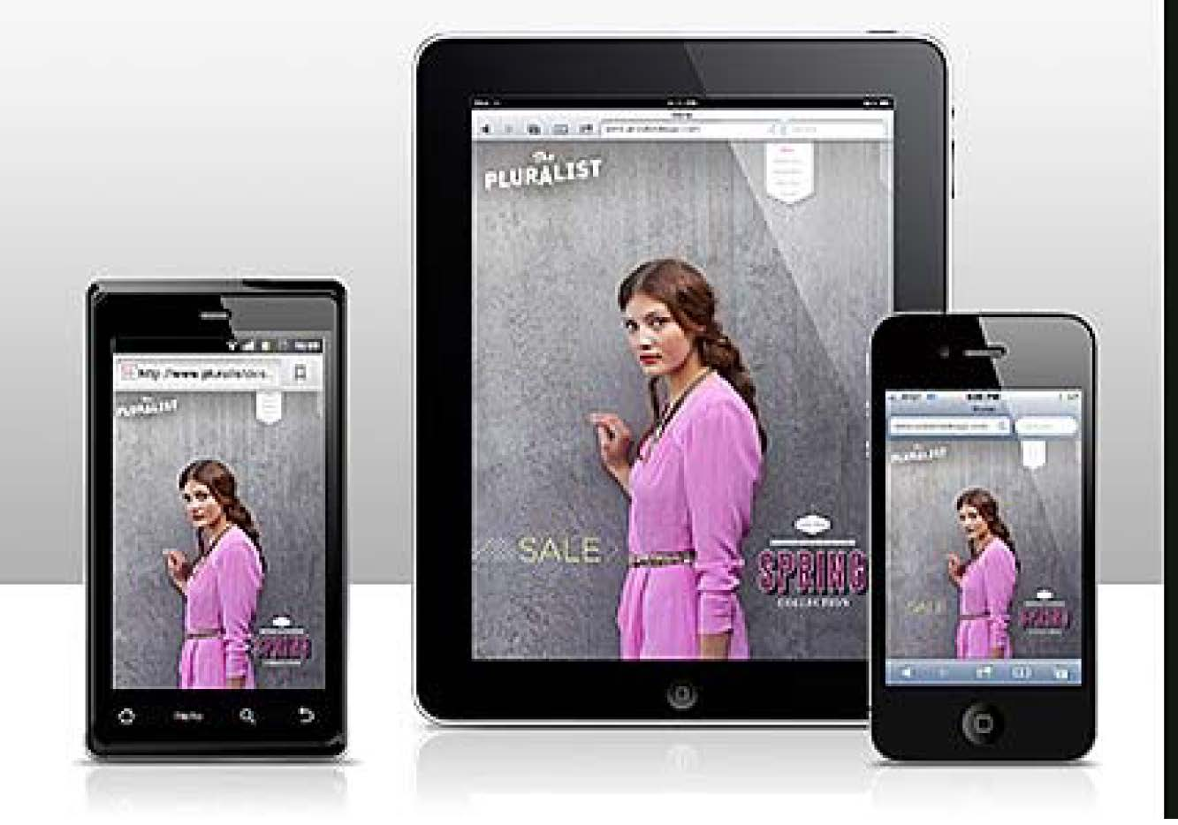
Coming December 11: Adobe Muse Update
The World’s Best Tools
Sync, Store & Share
Publish Apps & Websites
Stay a Step Ahead
Design websites without writing code
Complete design freedom
Low learning curve
Embraced by designers
40% of members have downloaded
30% of designers cite Muse as major driver
August: Built-in support for contact forms
December: Create tablet and smartphone versions of a website

Slide 24
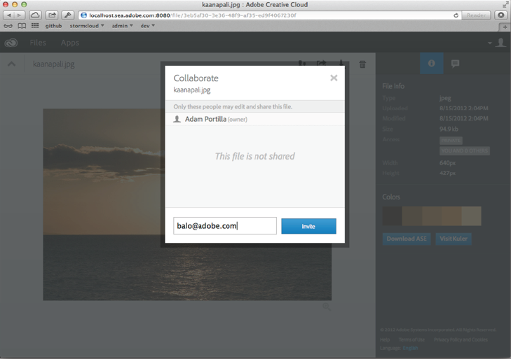
Coming December 11: Desktop Sync and Collaborative Sharing
The World’s Best Tools
Sync, Store & Share
Publish Apps & Websites
Stay a Step Ahead
Creative Cloud Connection
“Desktop sync”
Simplifies syncing to Cloud
Drag and drop files to a folder
Save to folder = save to Cloud
Collaborative Sharing
Share a file or share a folder
Share with one person
Share with a group *
* Coming soon

Slide 25
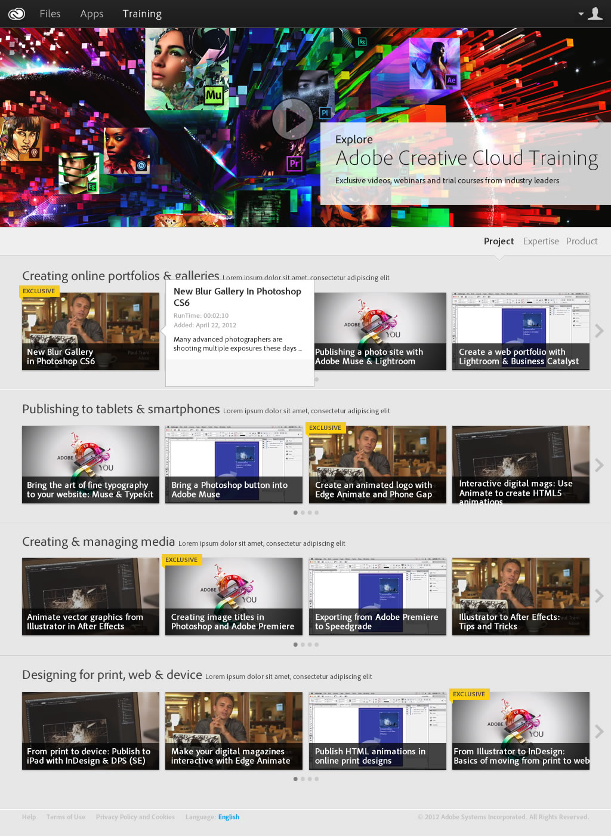
Coming December 11: Creative Cloud Training
The World’s Best Tools
Sync, Store & Share
Publish Apps & Websites
Stay a Step Ahead
Exclusive premium video training
From best-of-breed training partners
Seamlessly integrated into the Creative Cloud experience
Helps members expand their skills from creation to publishing
Just the beginning of partner ecosystem adding value
© 2012 Adobe Systems Incorporated. All Rights Reserved.
25

Slide 26




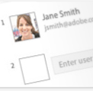

Coming December 11: Creative Cloud for Teams
The World’s Best Tools
Publish Apps & Websites
Share Widely, Collaborate Privately
The Files You Need, When You Need Them
Centralized Administration
Expert Support

Slide 27
CREATIVE CLOUD
for teams
Available Now!

Slide 28































What’s In Creative Cloud?
Get the World’s
Best Tools
Sync, Store &
Share
Publish Apps & Websites
Stay a Step Ahead
Device & PC Sync
Digital Publishing Suite
New products and updates as they become available
Photoshop
Illustrator
InDesign
Premiere Pro
After Effects
Audition
100 Gb
Cloud Storage
Business Catalyst
Training
Dreamweaver
Flash Pro
Fireworks
Muse
Lightroom
Acrobat
Share, Comment & Download
Typekit
Support
Edge Tools & Services

Slide 29















Creative Cloud for Teams – What’s In It?
The World’s Best Tools
Sync, Store
& Share
Publish Apps & Websites
Stay a Step Ahead
Photoshop
Illustrator
InDesign
Dreamweaver
100 GB
New products and updates as they become available
Business Catalyst
Device & PC Sync
Cloud Storage
Audition
Premiere Pro
After Effects
Fireworks
Share, Comment & Download
Typekit
Flash Pro
Acrobat
Edge
Muse
Lightroom 4
Digital Publishing Suite, Single Edition
Support*
Kuler
Photoshop
Touch
Collage
Proto
Debut
Ideas

Slide 30










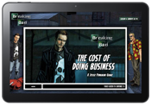

Re-imagining The Creative Process – From Concept to Publishing
Capture creative ideas on tablets
Refine concept
with desktop tools
Design for multiple layouts & formats
Publish & deliver to any screen

Slide 32
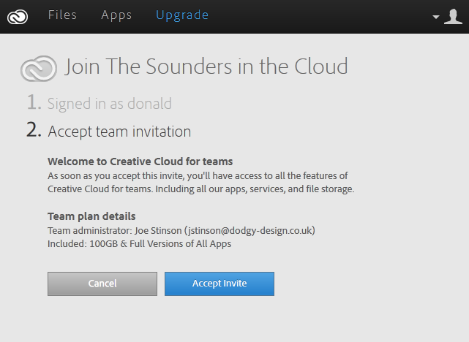
Creative Cloud for Teams Experience
Invitation

Slide 33
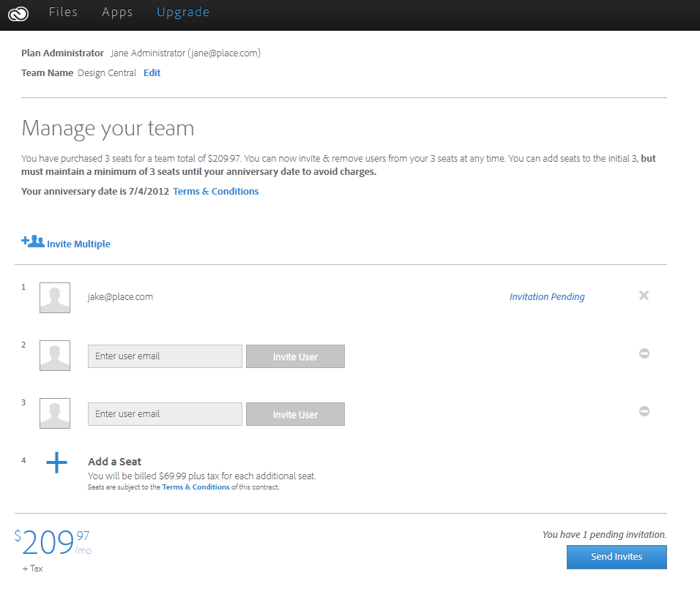
Creative Cloud for Teams Experience
Admin UI

Slide 34
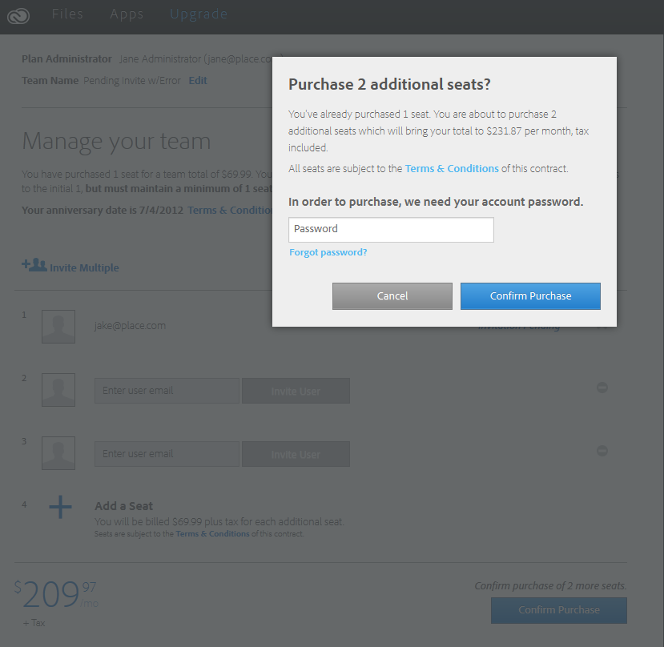
Creative Cloud for Teams Experience
Adding More Seats

Slide 35
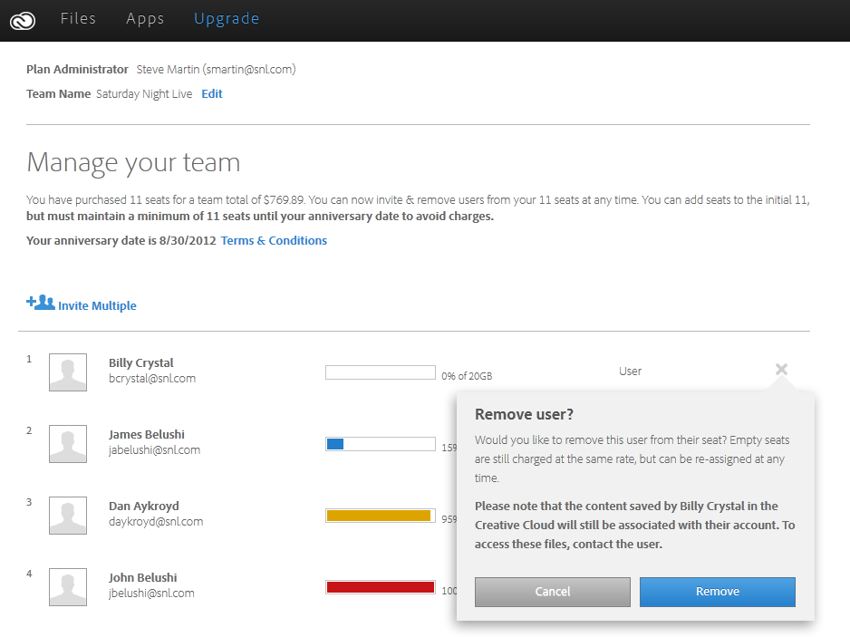
Creative Cloud for Teams Experience
Removing Seats

Slide 36





Adobe Creative Cloud for teams
The organizations you work with need to easily manage and scale their software investment, leverage centralized purchasing and use license management tools to assign, add or redeploy seats. They also need to share a larger set of files and collaborate with colleagues inside and outside their organizations.
Now you have a solution to offer your customers that truly meets these important needs.
It is called Creative Cloud for teams.
:
Presenter Notes:
Plus
CREATIVE CLOUD
Manage Licenses
More Storage
Share Files
Expert Support

Slide 37
Creative Cloud for teams is an ongoing membership that gives teams access to all of the Adobe Creative Suite® 6 desktop applications, plus other tools and services including Adobe Lightroom 4, Adobe Acrobat XI, Adobe Edge tools and services, and more.
Plus, everything that creative teams need at an incredibly low price.
Keep in mind that there is a similar introductory offer for the individual version of Creative Cloud and there still exists a price difference. Knowing the advantages for teams will help you communicate the value to your customer.
Presenter Notes:
 | €49⁹⁹ Creative Cloud for Individuals | €69⁹⁹ Creative Cloud For Teams
FEATURES
Master Collection CS6 | ✓ | ✓
Additional Desktop Apps | ✓ | ✓
Requires 1-yr contract | ✓ | ✓
Workgroup capabilities |  | ✓
License management for workgroups |  | ✓
Centralized billing |  | ✓
Expert Services |  | ✓
File Storage | 20GB | 100GB
Creative Cloud
Per Month
Per Month
* 12 months Paid upfront
List Price €839 per seat

Slide 38
Creative Cloud for teams is an ongoing membership that gives teams access to all of the Adobe Creative Suite® 6 desktop applications, plus other tools and services including Adobe Lightroom 4, Adobe Acrobat XI, Adobe Edge tools and services, and more.
Plus, everything that creative teams need at an incredibly low price.
Keep in mind that there is a similar introductory offer for the individual version of Creative Cloud and there still exists a price difference. Knowing the advantages for teams will help you communicate the value to your customer.
Presenter Notes:
 | €29⁹⁹ Creative Cloud for Individuals | €49⁹⁹ Creative Cloud For Teams
FEATURES
Master Collection CS6 | ✓ | ✓
Additional Desktop Apps | ✓ | ✓
Requires 1-yr contract | ✓ | ✓
Workgroup capabilities |  | ✓
License management for workgroups |  | ✓
Centralized billing |  | ✓
Expert Services |  | ✓
File Storage | 20GB | 100GB
Creative Cloud
for current customers
Per Month
Per Month
(CS3 or later)
* 12 months Paid upfront
List Price €839 per seat

Slide 39
Creative Cloud for teams vs Creative Cloud for individuals
 | Creative Cloud for Individuals | Creative Cloud For Teams
Is the membership permanently associated with an individual? | YES | NO
Can the membership be reassigned to another user? | NO | YES
Does the membership stay with the organization if an employee leaves? | NO | YES
Are memberships and deployment managed centrally? | NO | YES
What are the purchasing options? | Credit Card | Purchased under licensing

Slide 41
What’s your opportunity
Revenue
More
Predictable
Easier
Current customers
New customers
Recurring renewals
Predictable growth
Renewal bookings are easier than selling upgrades

Slide 42
More Revenue
Current
Customers
(priority)
New
Customers
Deeper penetration within existing accounts
More attractive value proposition than upgrade
Ongoing membership increases lifetime value of customers
@Work Professionals
14.3 million
Half are in small-med business
90% do not own Adobe CS tools
High Adobe brand and product affinity
Purchasing authority
Aspire to use our creative tools

Slide 43
Predictable Revenue
Recurring
Renewals
Predictable
Growth
Visibility into monthly renewals
1:1 Customer : reseller relationship
Recurring every 12 months
Cumulative effect
Upgrade
Revenue
10
New
10
New
40
Renewals
10
New
30
Renewals
10
New
20
Renewals
Membership
Revenue
10
New
10
Renewals
YR 1
YR 2
YR 3
YR 4

Slide 44


Predictable Revenue
Start Date
Anniversary Date
5
SEATS ADDED
5 Seat for 12 mos.
12 mos. X €49.99 = €600 ea.
€3,000
16
SEATS ADDED
16 Seats for 9 mos.
9 mos. X €49.99 = €450 ea
€7,200
21
SEAT RENEWAL
Order 21 Seats
12 mos. X €69.95 = €840
€17,640
Notification of upcoming anniversary date
Month
1
2
3
4
5
6
7
8
9
10
11
12
1
*Pricing is for illustration purposes only

Slide 45
Easier Revenue
Gets past the top Reasons for not upgrading
“Not in my budget”
“What I have is good enough”
Easier purchase process for customer
Operational expense versus capital expense
Renewals are easier than upgrades

Slide 46
Summary
Available Q1
The next evolution of CCM
A great revenue opportunity
The future of Creative Suite
CREATIVE CLOUD
for teams

Slide 47
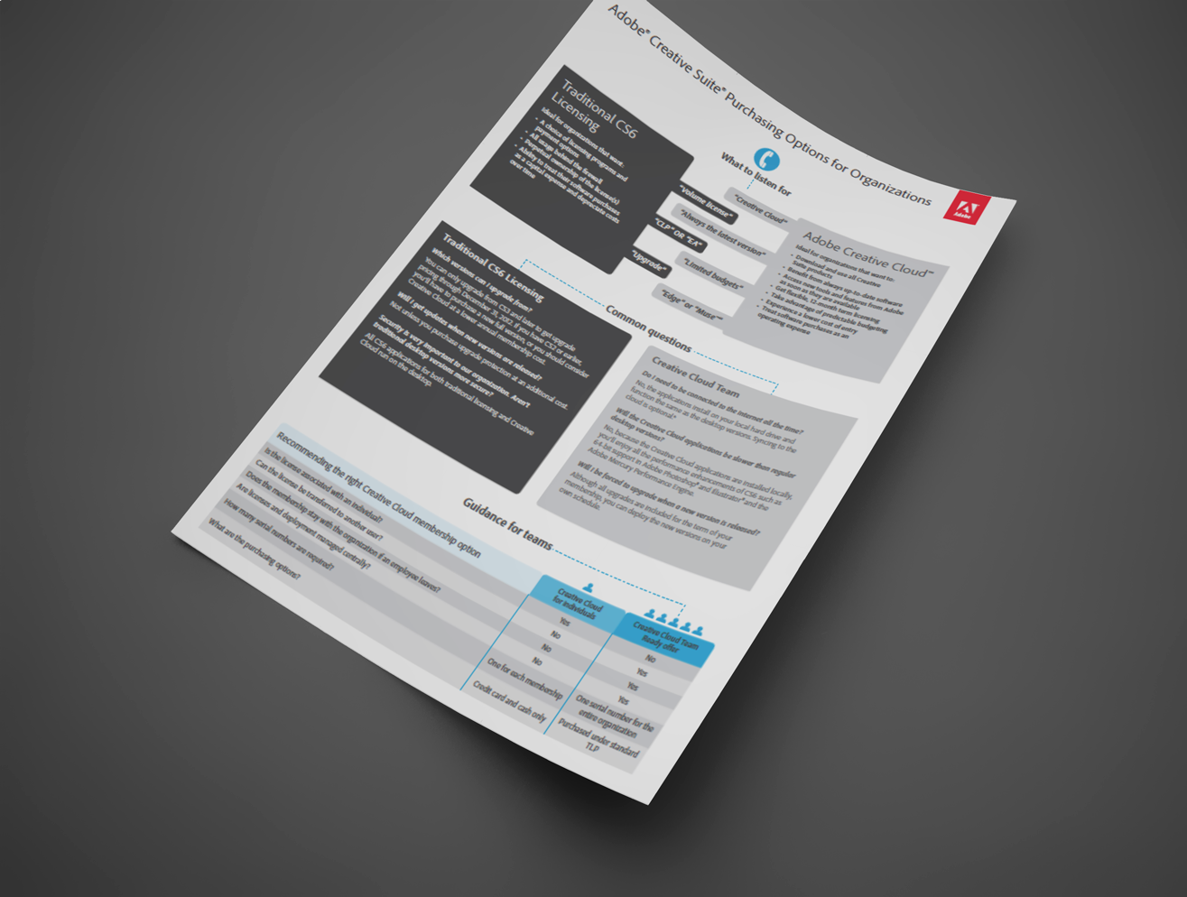
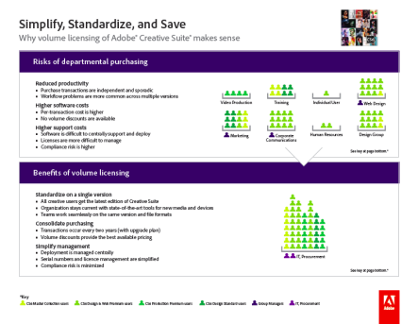
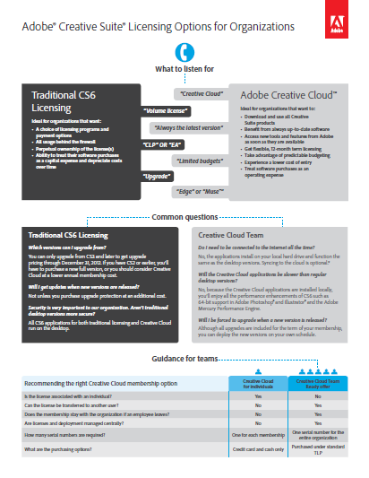
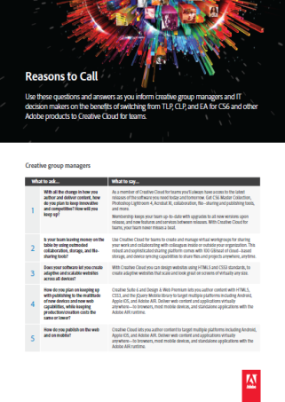
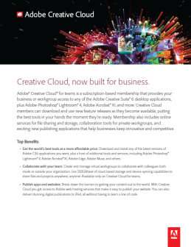
Creative Cloud for teams Sales Tools
Reseller sales training
Creative Cloud for teams - overview
Grow your deals
CS Licensing options for organizations
Reasons to call
Channel copy blocks
AIG (Adobe Interactive Guide)
Reseller sales training

Slide 48

Value Incentive Plan

Slide 49
VIP Overview
Value Incentive Plan (VIP)
Ongoing membership-based plan
Offers subscription licenses through APC Certified, Gold, & Platinum Resellers
Worldwide* for commercial, education & government customers
Creative Cloud for teams at launch
First order date expected… soon (with the launch of Creative Cloud for teams)
* Except China

Slide 50



Adobe Licensing Programs at a Glance
Multiple seats on a single order | ✓ | ✓ | ✓
Predictable budgeting |  | ✓ | ✓
Version updates** |  | ✓ | ✓
Easier compliance management |  |  | ✓
Lower cost of entry
The latest applications, features and services between releases
Easily view purchased vs. added
**for customers with Upgrade Plan in CLP

Slide 51

Adobe Licensing Programs Overview
Multiple seats on a single order | ✓ | ✓ | ✓ | ✓
Predictable budgeting |  | ✓ | ✓ | ✓
Version updates** |  | ✓ | ✓ | ✓
Easier compliance management |  |  | ✓ | ✓
Lower cost of entry |  |  |  | ✓
The latest applications, features and services between releases |  |  |  | ✓
Easily view purchased vs. added |  |  |  | ✓
**for customers with Upgrade Plan in CLP

Slide 52
VIP membership features
Evergreen agreement
Anniversary Date each year establishes co-termination across products
Renew all products on the same date each year.
Products pro-rated monthly
Each customer = one VIP Number
Best practice—always ask for their VIP Number

Slide 53





Reseller-driven process
1
INVITE
Reseller invites customer to VIP Program
Reseller receives notification of customer acceptance
Reseller
3
VIP # ISSUED
to Reseller and Customer. Anniversary date established.
VIP SYSTEM
2
ACCEPT
Customer accepts terms via the web and adds seats immediately
4
ASSIGN USERS
Customer assigns seats to users
Customer

Slide 54
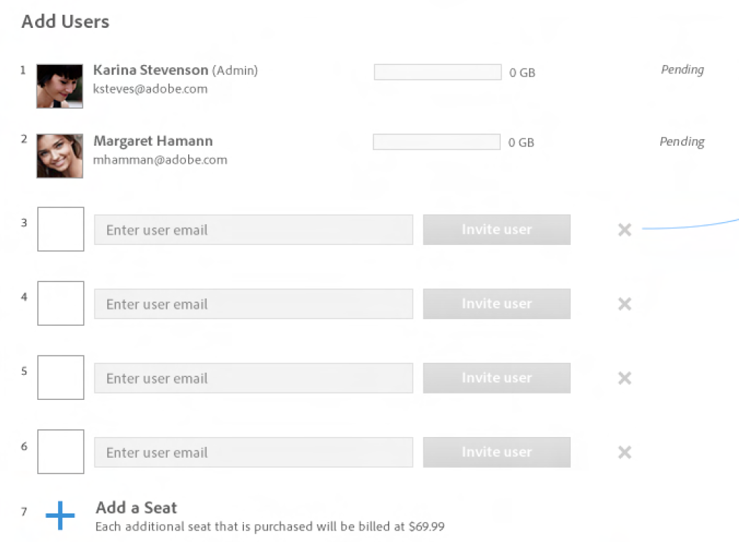
Customer Admin Console

Slide 55

Reseller and Customer Views
YOUR VIEW
check on the number of seats your customer has ordered, add seats,
handle their purchase orders
Renewals due
Get details on exactly what to order
Place order with Adobe within 30 days
VIP #
Reseller
SYSTEM
System links customer and reseller together
tracks seats added, renewal dates
VIP SYSTEM
CUSTOMER VIEW
summary level information on what they’ve purchased vs. added
instantly access a license as soon as they enroll in the program and begin using the software immediately.
Add additional seats
Automatic compliance
Assign & reassign seats
View number of licenses purchased vs. added
VIP #
Customer

Slide 56



Adding seats and placing orders
3
RESELLER PLACES ORDER
With Adobe or distributor
Reseller
2
SYSTEM CALCULATES duration based on anniversary date informs reseller
SEATS PURCHASED
System displays seats that have been purchased
VIP SYSTEM
1
SEATS ADDED
Customer adds seats and authorizes purchase.
4
PAY BILL
Customer pays reseller
Without reseller order customer software stops working
Customer
30 days

Slide 57
Additional Info for Resellers
Adding seats is different from making a purchase
Purchase is made through Reseller.
Adobe must receive and process order within 30 days
Automatic compliance means software stops working
Notifications to Reseller
Customer adds seats
Customer is over deployed
Renewals due

Slide 58
Best Practices
Keep one VIP Number
Work with one Reseller
Use a PO Number, or Purchase Authorization Number

Slide 59
Customer and Reseller Benefits
Customer benefits from:
Reseller benefits from:
immediate access to latest products and features
a simple sign up process
lower up-front cost
freedom from minimum entry requirements
ability to work with Adobe Authorized Resellers
option to pay with a Purchase Order
automatic compliance
ability to add additional seats
ability to assign & reassign seats
a quick view of purchased vs. added seats
all products and seats purchased through VIP co-terminate
opportunity to increase trusted advisor status by managing customer’s licenses
linked to customer which enables Reseller to be notified of renewal opportunity
time saving customer management via the Reseller Console
automatic pro-ration calculation for duration of subscription
worry free tracking and automatic notification of purchases, renewals
customers who have more money to spend with you
Reseller
VIP SYSTEM
Customer

Slide 60
How do Resellers sign up?
Reseller receives email from Adobe (designated contact person)
Add additional reseller staff
Invite customers

Slide 61
Key Take Aways
1
Creative Cloud gives you everything you need to create anything you can imagine
Creative Cloud is the best way for Creative Pros to continue to receive the latest innovation from Adobe – at no extra cost
You can now get Creative Cloud for your team
2
3

Slide 63

How to sell Creative Cloud for Teams
?
?
?
?
?
?

Slide 64
Challenges for the Channel
We have to sell against Creative Cloud Individual.
A.com offers Creative Cloud for Teams as well.
Creative Cloud for Team is more expensive than perpetual upgrade.
The customer thinks he is paying to much since he is not using all of the tools offered.
The customer likes the idea of paying each month.

Slide 65
How to sell Creative Cloud for Teams
Focus on Business users
Focus on CS3, CS4 en CS5 users
Focus on IT manager
Focus on business manager
Focus on 2-up workgroups
Attach it!
Register your deals (a.s.a.p.)
CC for Teams
CC for Individuals

Slide 66
How to sell Creative Cloud for Teams
Step 1
Learn about you customers challenges, pain points, business opportunities and budget
Step 2
Let the customer now you understand their needs, talk about solutions and opportunities.
Step 3
Propose Creative Cloud for Teams or else…

Slide 67
How to sell Creative Cloud for Teams - example
Step 1
Customer tells about the business being difficult, low prices and customers want to publish to web and mobile…
Step 2
I understand, so you would like to add more value and use your skills to design their websites and apps…
Step 3
With Creative Cloud for Team this is all possible…

Slide 68
How to sell Creative Cloud for Teams
Tip 1
Highlight your added value!
You know about the customers business
You know what is best for your customer
You’re his trusted advisor
You are going for the long term relationship
Your care about your customers continuity
You are a service provider

Slide 69
How to sell Creative Cloud for Teams
Tip 2
Do your own marketing
Talk to your customer about your added value
point out your service to the customer
Tell about your successes
Use your website to show your success
Let customers talk about you (interview)
Service ≠ Free of Charge

Slide 71
Key Values of Creative Cloud for Teams
1
Easy License and compliancy management
Predictable budgeting, always up-to-date
A single invoice per year, annual renewal
2
3

Slide 72
Additional Values of Creative Cloud for Teams
4
Easy software deployment
Adobe Expert support
More cloud storage – collaboration space
5
6

